Slide 1
Malicious DNS Traffic Detection Using Deep Learning
Group Members:
Abhishek kumar Singh
Ankit Kumar
B.Dheeraj Chandan
Kothapalli Mounika
Manchi Tejasai

Slide 2
Contents
Abstract
Introduction to DNS, Security, DNS Traffic
Real-Time Applications and Examples
The Role of Deep Learning in DNS Traffic Detection
Features for DNS Traffic
Requirements for Detecting Malicious Sites
Deep Learning Algorithm Code Screenshots and Results
References
Conclusion

Slide 3
Abstract
The project aims to develop a deep learning based system to detect malicious DNS traffic, pose as a cyber threat and threat to the DNS eco system. Domains linked to malicious DNS traffic are used to carry out cyber attacks such as phishing, malware distribution, botnet and another similar attacks.
In the project, we take real DNS log files as input, parse them and apply deep learning on it to classify the DNS traffic as malicious or benign.

Slide 4
Introduction to DNS, Security, DNS Traffic
Introduction to DNS:
- Reffered as "Phonebook of the internet"
- Translates human-readable domain names into IP addresses
- Importance : Essential for accessing websites and online services.
- Working : Process of resolving domain names to IP addresses
Purpose:
Importance : Preventing security breaches and maintaining data integrity.
Involves monitoring and analyzing DNS queries and responses within a network to identify patterns, detect anomalies, and enhance security.

Slide 5
Real-Time Applications and Examples
Plays a crucial role in maintaining network security, preventing cyber threats, and ensuring the smooth operation of internet services.
Real-time applications and examples :
Anomaly Detection: Spot unusual DNS traffic patterns instantly.
Enforce Network Policies: Block unauthorized content in real-time.
Incident Response: Provide immediate data for swift threat mitigation.
Prevent Data Exfiltration: Detect and block suspicious DNS queries.
Intrusion Detection: Monitor DNS for signs of attacks.
Web Filtering: Instantly block access to malicious domains.
Malware Prevention: Disrupt Command-and-Control (C2) communications.
Phishing Protection: Real-time detection of phishing domains.
SIEM Integration: Enhance threat analysis with live DNS data.
Real-time DNS traffic detection is a powerful tool for enhancing network security and optimizing performance.

Slide 6
The Role of Deep Learning in DNS Traffic Detection
Deep learning involves training neural networks with multiple layers to automatically learn complex patterns from large datasets. This makes it particularly well-suited for DNS traffic detection, as it eliminates the need for manual feature extraction.
Advantages of Deep Learning for DNS Traffic Detection:
Feature Learning: Automatically extracts features from raw DNS data,
Reducing the need for manual intervention and improving adaptability to new threats.
Pattern Recognition:
Excels at recognizing complex patterns,
identifying subtle indicators of malicious activity that traditional methods might miss.
Adaptability:
Can be retrained with new data to continuously adapt to evolving threats,
Maintaining high detection accuracy.

Slide 7
Features for DNS Traffic
Key Features:
Anomaly Detection: Identifying unusual patterns in DNS traffic.
Traffic Pattern Analysis: Understanding traffic trends and spikes.
Identification of Unusual Query Behaviors: Detecting queries that deviate from the norm.
Feature Engineering:
Features extraction from DNS Queries: Methods for deriving meaningful features.
Role : Enhancing model performance through effective feature selection

Slide 8
Requirements for Detecting Malicious Sites (Hardware and Software)
Hardware Requirements: Computational Resources like CPUs/GPUs, memory, and storage needs.
Software Requirements:
Libraries and Tools like
Pandas : For data manipulation ,analysis, handling and working with DataFrames and Series.
NumPy : For numerical computing on arrays, matrices, and mathematical functions for efficient data processing.
Scikit-learn : Tools for data mining and data analysis, Includes algorithms for classification, regression, clustering, and more.
TensorFlow : For building and training deep learning models, supports types of neural networks and large-scale machine learning.
PyTorch : For its flexibility and ease of use, Tools for building and training neural networks with dynamic computation graphs.
Visualization Tools:
Matplotlib : A library for creating various types of plots and graphs in Python
Seaborn : A library that enhances Matplotlib by making it easier to create beautiful and informative statistical visualizations.

Slide 9
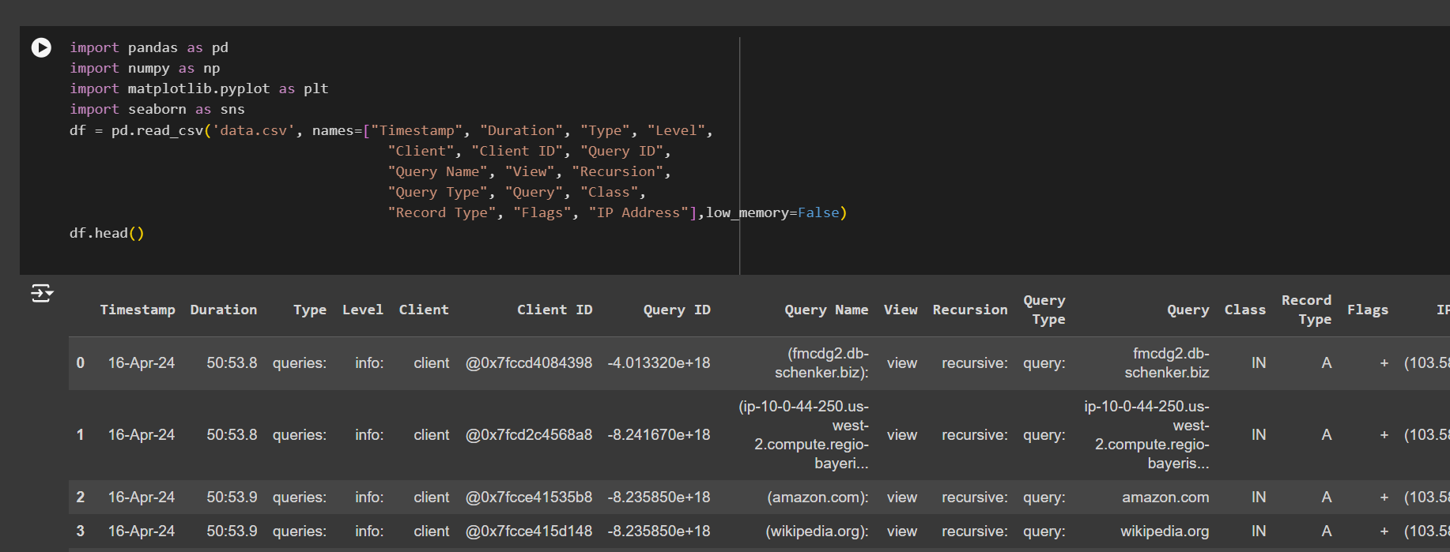
Deep Learning Algorithm Code Screenshots and Results
` The pd.read_csv() function reads the CSV file into a DataFrame with specified column names for easier data handling and analysis.
The low_memory=False parameter ensures proper type inference for large datasets, avoiding potential issues with mixed data types

Slide 10
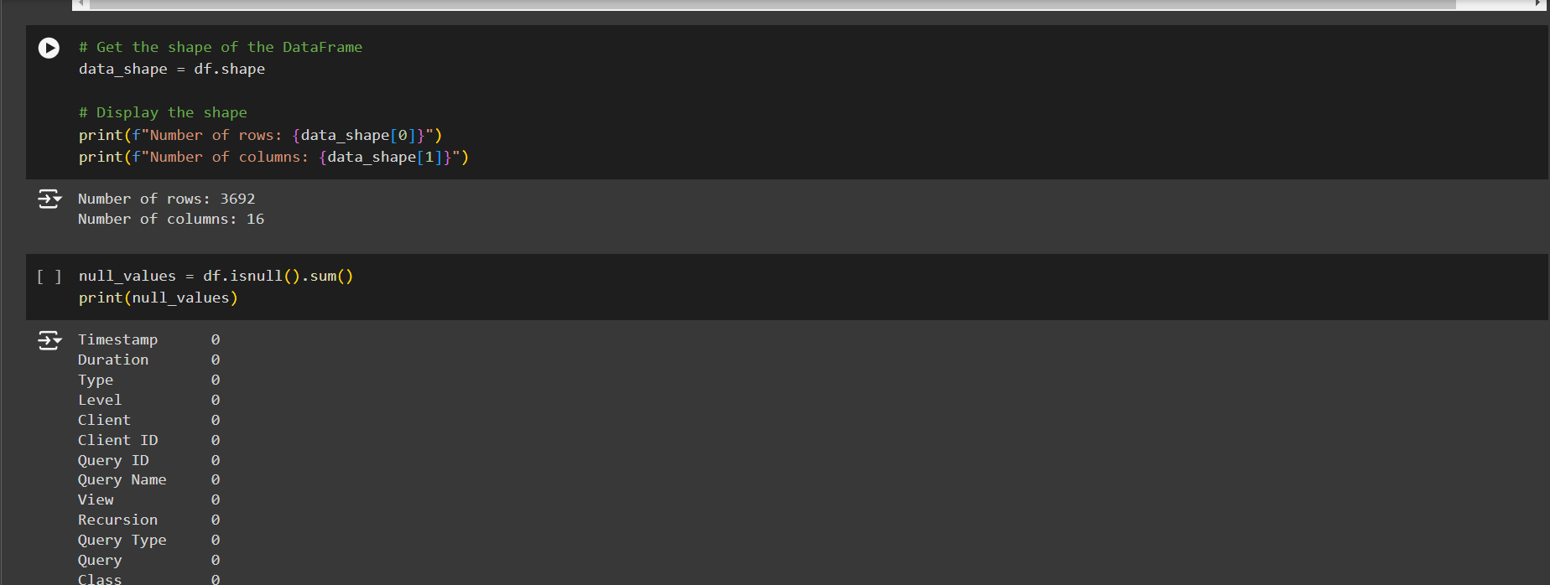
The code retrieves and prints the number of rows and columns in the DataFrame, providing an overview of its dimensions.
Calculates and displays the count of null values in each column to identify any missing data.

Slide 11
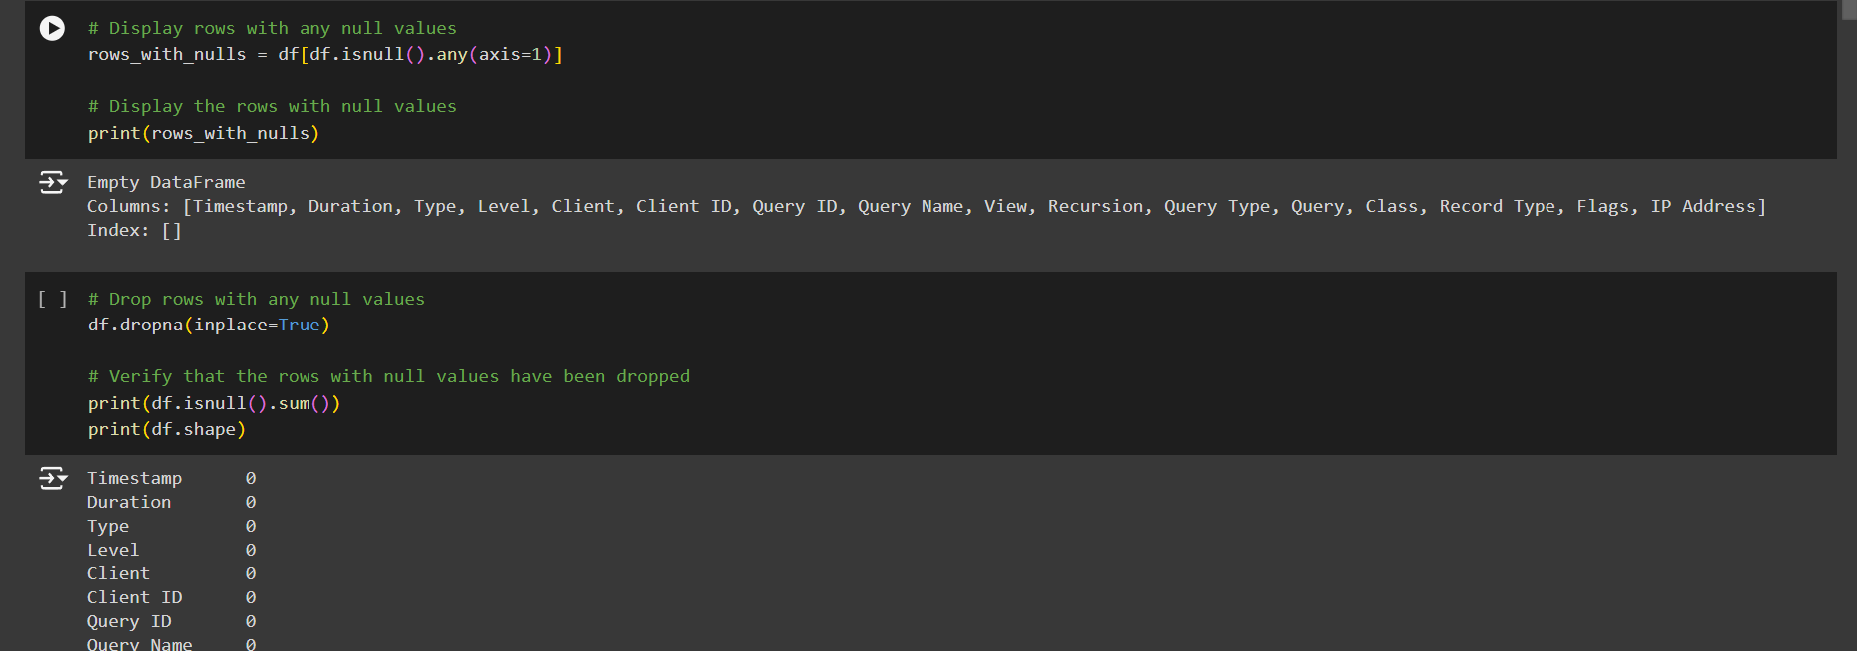
Identifies and displays rows containing any null values, allowing for inspection of incomplete data.
Removes these rows from the DataFrame and verifies the operation by checking for remaining null values and the updated shape of the DataFrame.

Slide 12
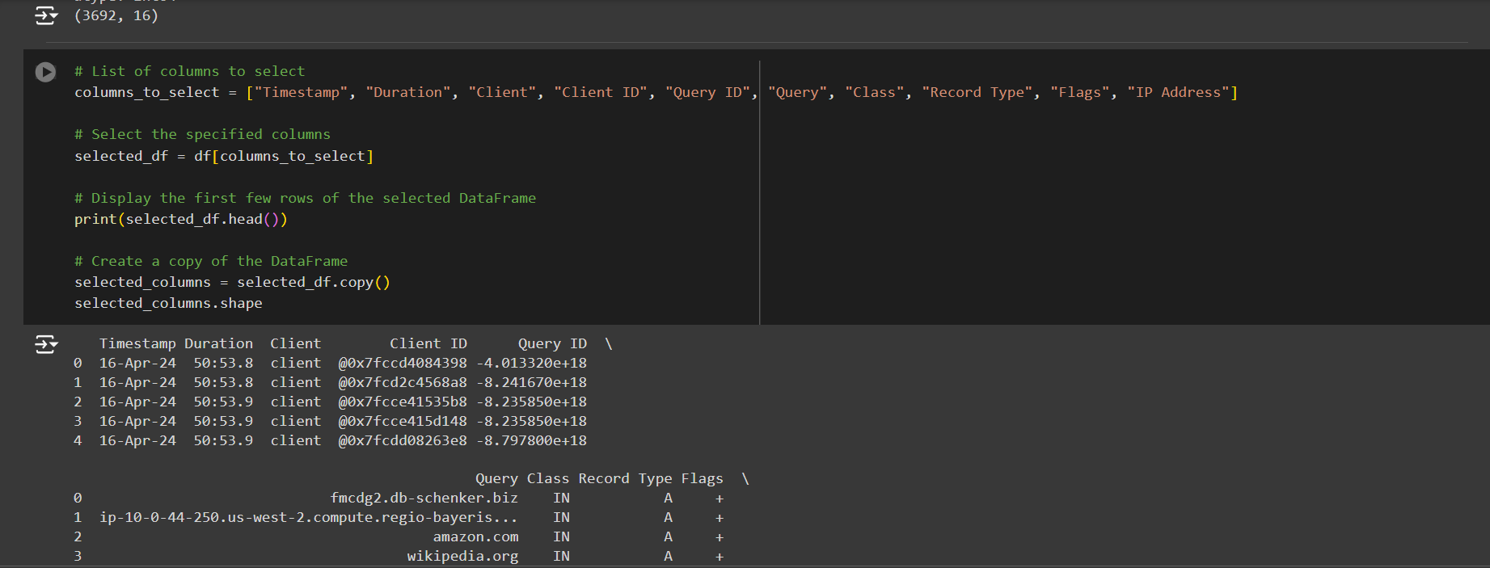
• The code selects a subset of columns from the DataFrame based on the specified list and displays the first few rows of this new DataFrame.
• Then creates a copy of the selected columns DataFrame and checks its shape to confirm the operation.
Class : Field in a DNS record specifies the protocol group or namespace the DNS record belongs to.
Record : Kind of data stored in the DNS record
Flags : Indicate the status of the response.

Slide 13
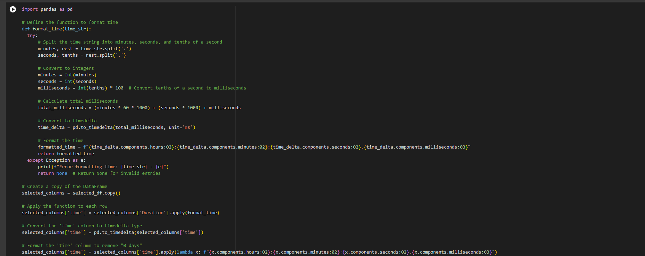
Converting time strings from a "minutes:seconds.tenths" format into a formatted time string in "HH:MM:SS.MMM" format by converting to a timedelta object.
A copy of the selected_df DataFrame is created, and the format_time function is applied to the 'Duration' column to generate a new 'time' column with formatted time strings.
'time' column is converted to timedelta type, and a lambda function reformats the timedelta values to remove any "0 days" component.
Updated DataFrame with the formatted 'time' column is printed, showing the newly formatted time values.

Slide 14
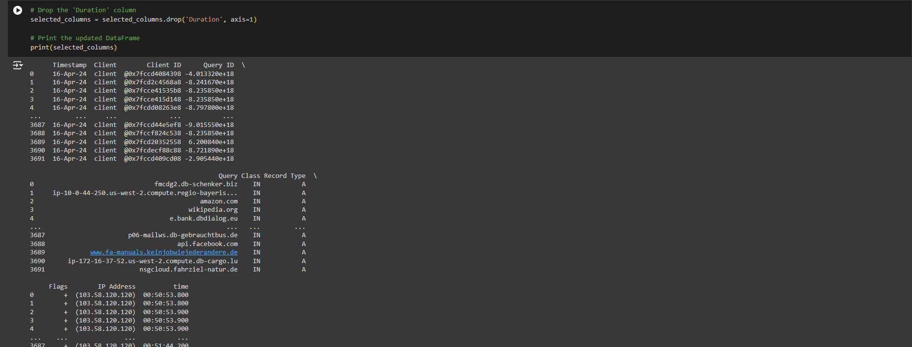
Removes the 'Duration' column from the DataFrame, leaving only the formatted 'time' column and other selected columns.
Prints the updated DataFrame to show the result after the column removal.

Slide 15
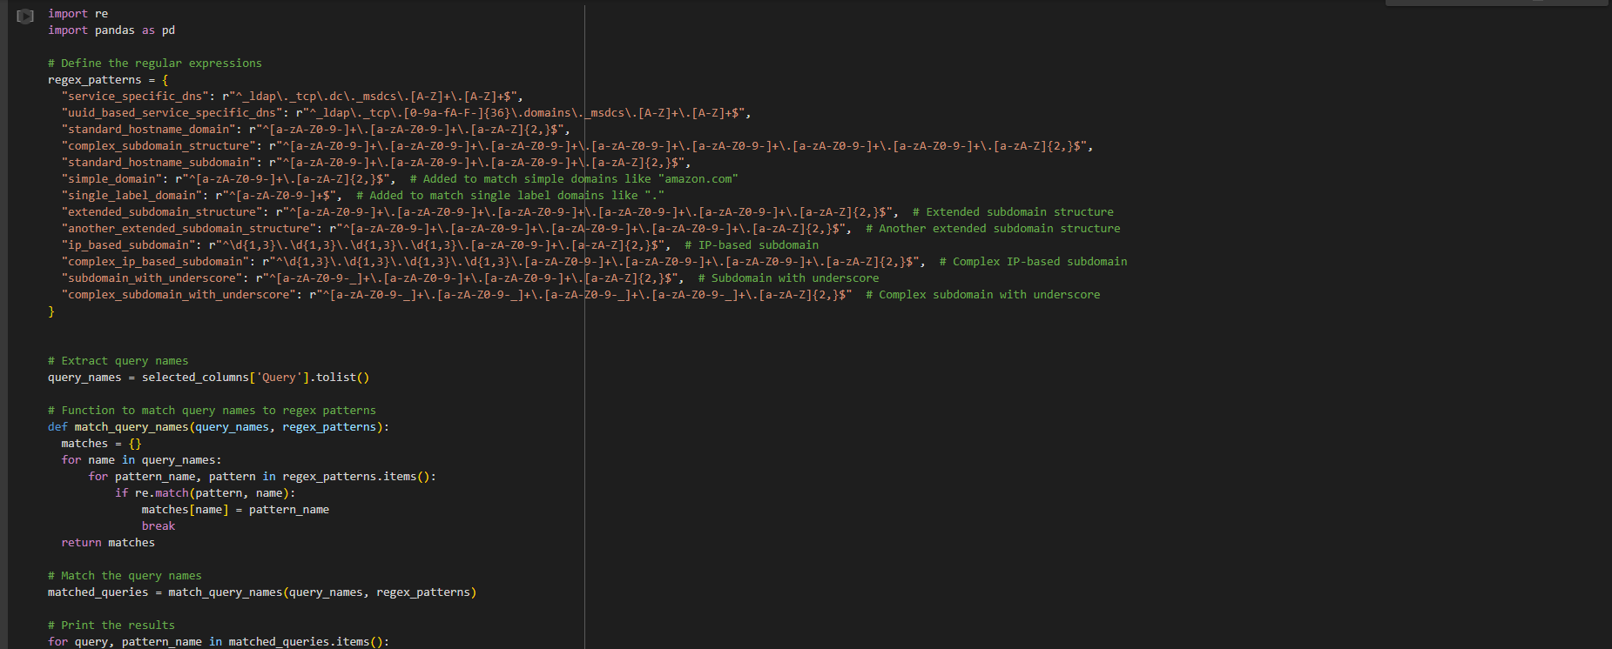
Set of regular expressions to match various DNS query patterns and extracts the list of DNS query names from the selected_columns DataFrame and then uses the match_query_names function to compare each query name against the defined patterns.
Function returns a dictionary of matched queries, which is then printed, showing each query name alongside the pattern it matches.
Helps categorize DNS queries based on predefined patterns, aiding in analysis and understanding of query types.
Regex patterns include various formats for domain names, subdomains, and IP-based structures, ensuring comprehensive matching

Slide 16
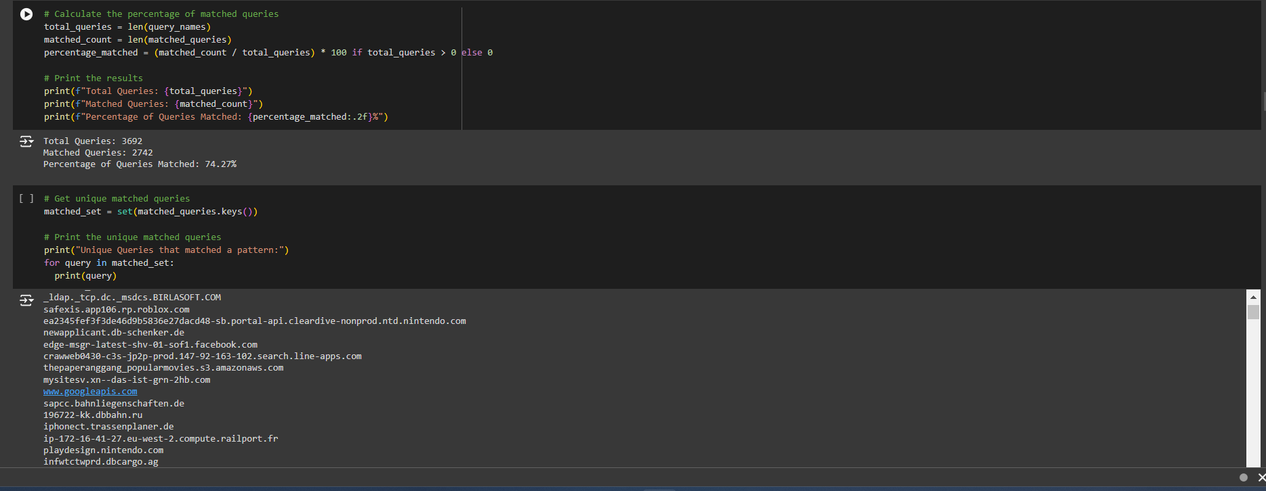
Calculates the percentage of queries that matched one of the regex patterns by dividing the number of matched queries by the total number of queries and multiplying by 100.
Prints the total number of queries, the count of matched queries, and the percentage of queries that matched any pattern.
Extracts and prints the unique query names that matched a pattern, providing a list of distinct queries that fit the defined patterns.
Analysis helps in understanding the proportion and variety of queries that conform to the specified regex patterns.

Slide 17
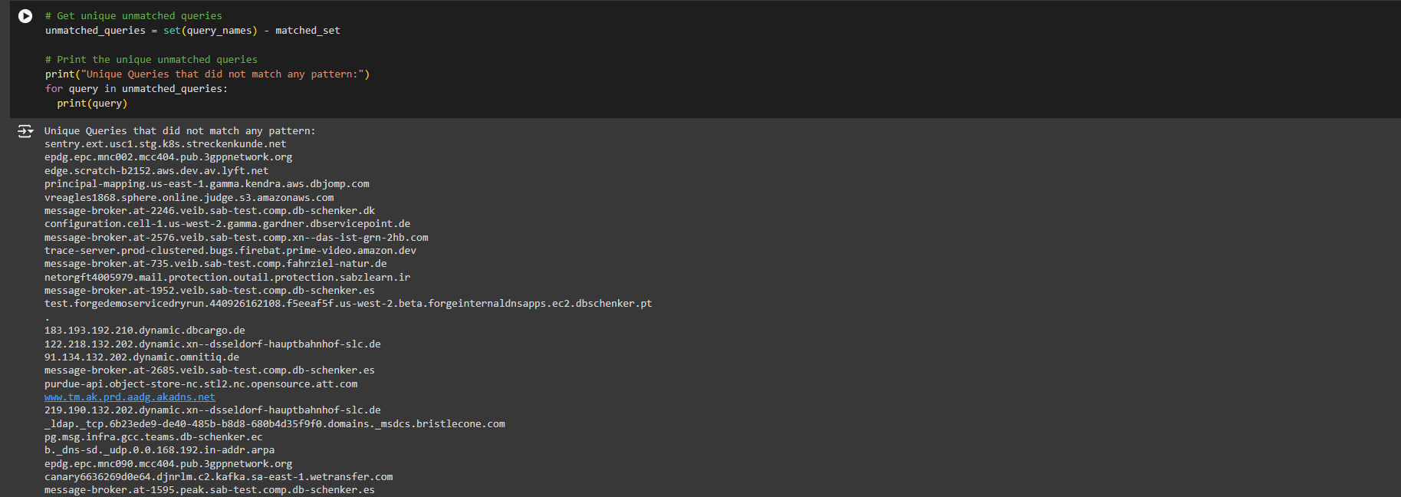
Identifies queries that did not match any regex patterns by subtracting the set of matched queries from the set of all query names.
Prints the unique queries that did not match any pattern, highlighting queries that fall outside the predefined patterns.

Slide 18
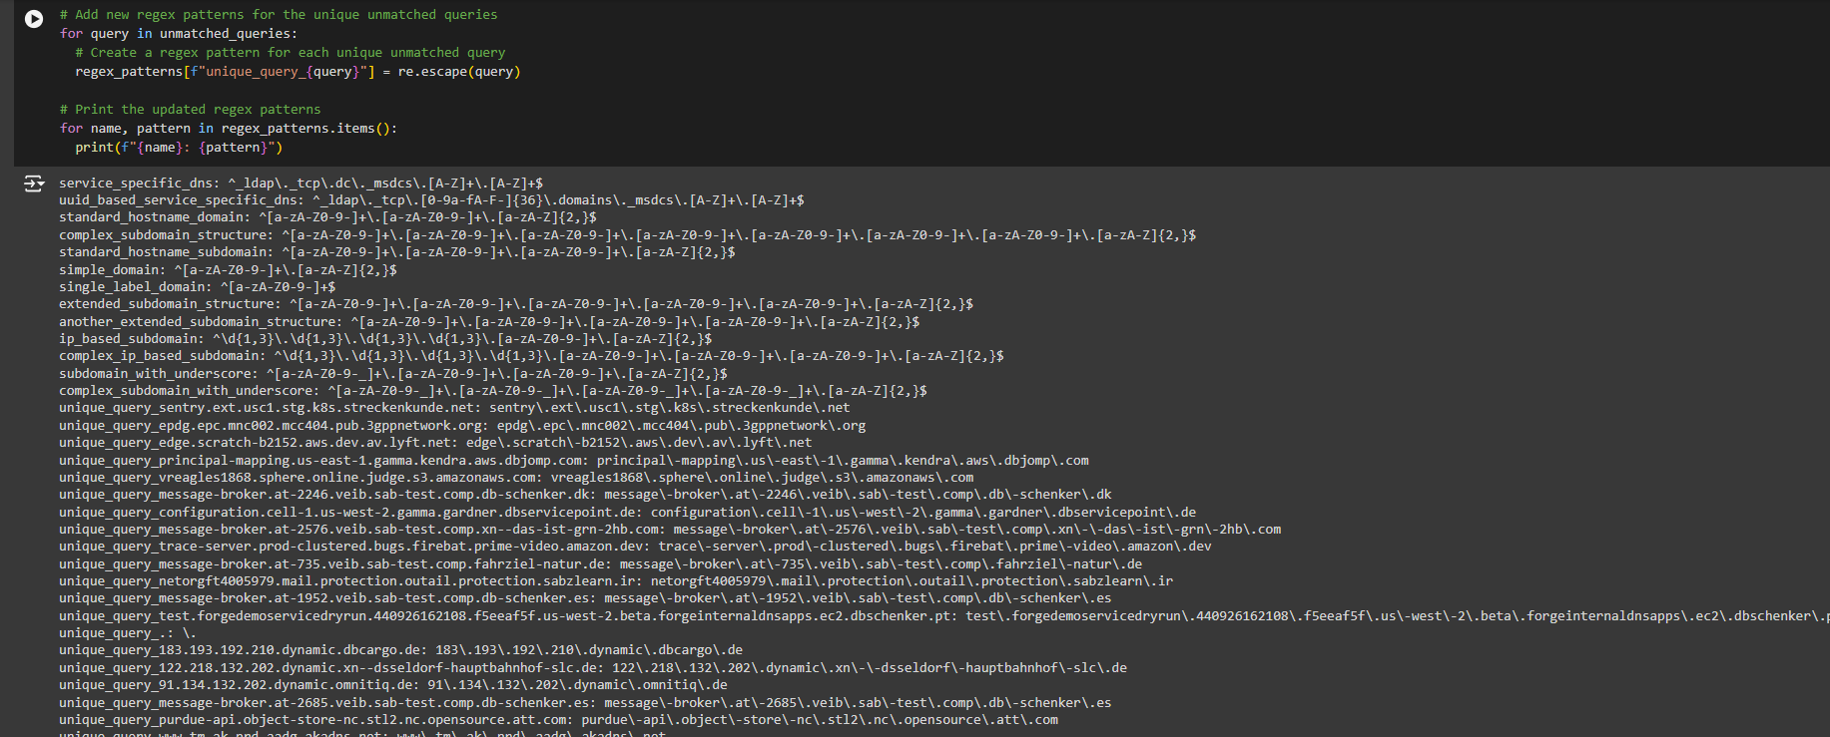
Code adds new regex patterns for each unique unmatched query by escaping special characters in the query and creating a pattern that matches the exact query string.
Prints the updated list of regex patterns, including the newly added patterns for previously unmatched queries.

Slide 19
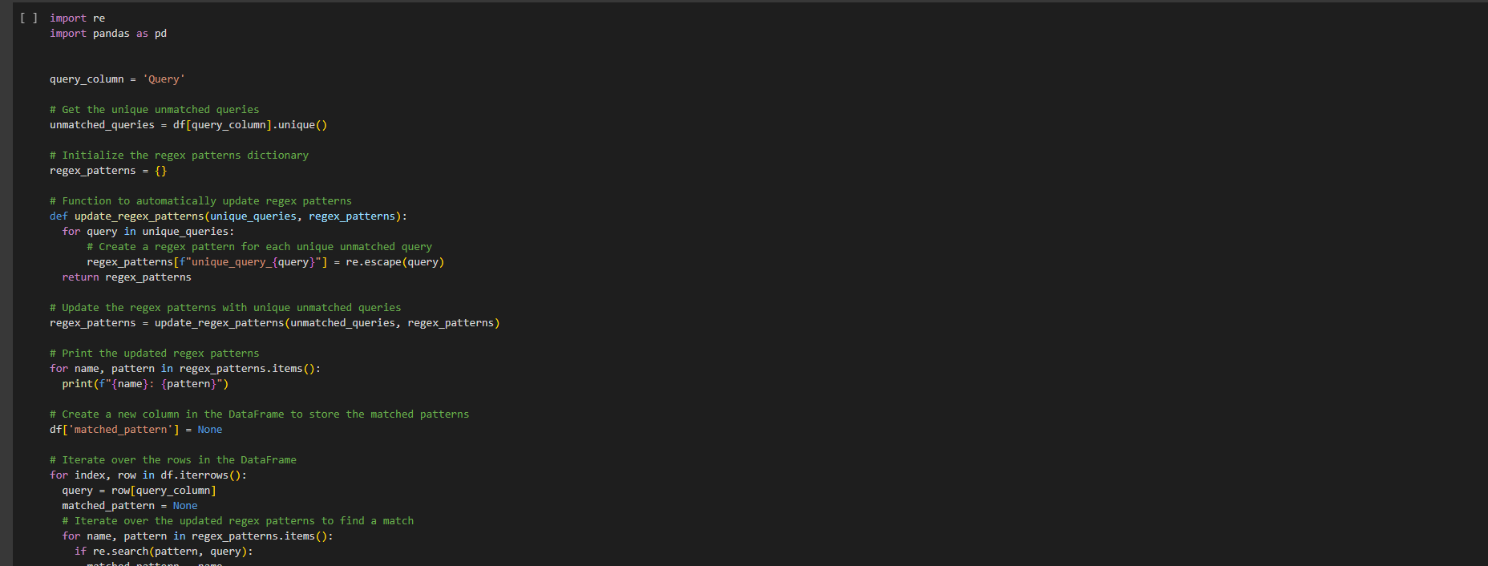
Extracts unique unmatched queries from the DataFrame and initializes a dictionary to store regex patterns for these queries.
Updates the regex patterns dictionary by creating patterns for each unique unmatched query using re.escape() to handle special characters.
New column, 'matched_pattern', is added to the DataFrame to store which pattern matches each query, and the code iterates through the DataFrame to populate this column.
Prints the updated DataFrame showing the new 'matched_pattern' column with the matched regex patterns for each query.

Slide 20
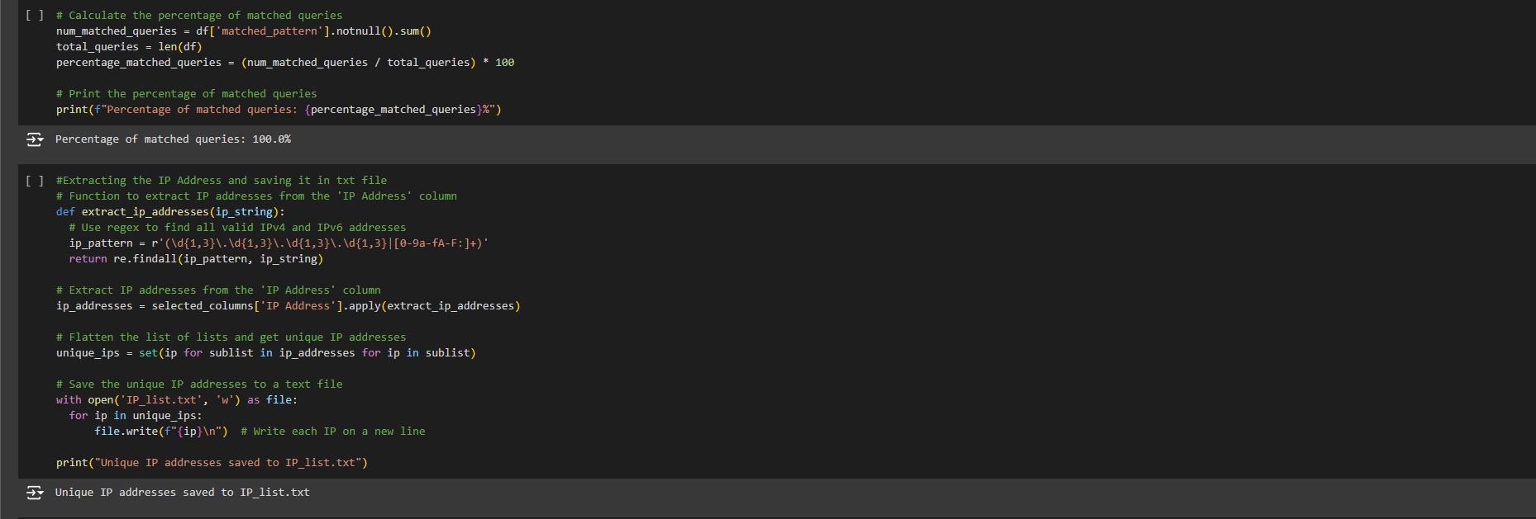
Calculates the percentage of queries that matched any regex pattern by counting non-null entries in the 'matched_pattern' column and dividing by the total number of queries.
Prints this percentage to provide insight into the proportion of queries that fit the updated patterns.
Extract_ip_addresses function uses regex to find both IPv4 and IPv6 addresses in the 'IP Address' column and extracts them into a list.
Unique IP addresses are then saved to a text file, 'IP_list.txt', with each IP address written on a new line, and a confirmation message is printed.

Slide 21
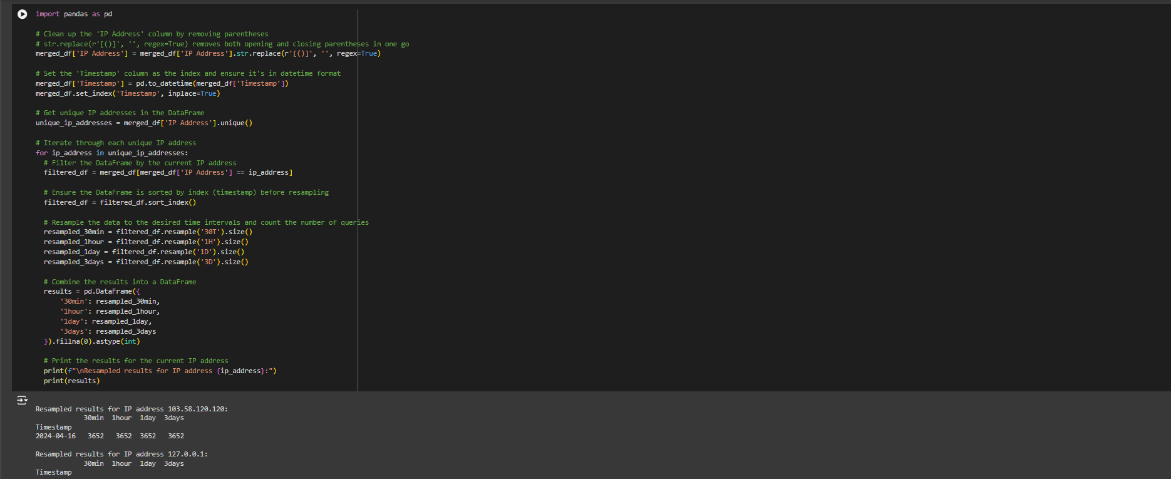
Cleans the 'IP Address' column by removing parentheses and sets the 'Timestamp' column as the index in datetime format.
Extracts unique IP addresses and, for each one, filters the DataFrame, sorts it by timestamp, and resamples the data at 30-minute, 1-hour, 1-day, and 3-daya intervals to count the number of queries.
These resampled results are combined into a DataFrame and printed for each IP address.

Slide 22
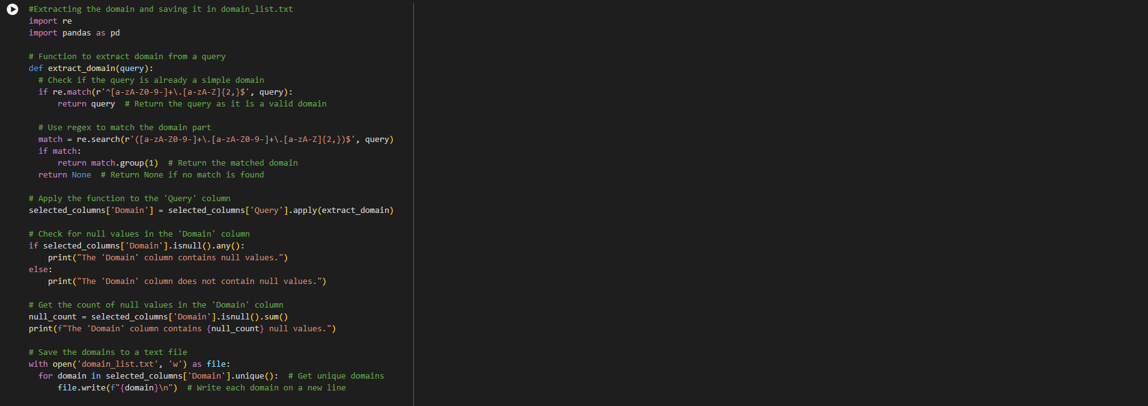
Defines a function to extract domains from DNS query strings, checking if the query matches a domain format or extracting the domain part using regex.
Apply function to the 'Query' column, adding the extracted domains to a new 'Domain' column in the DataFrame.
Checks for and reports any null values in the 'Domain' column, printing the count of null entries if any exist.
Save the unique domains to a text file, 'domain_list.txt', and prints the updated DataFrame showing the original queries alongside the extracted domains.

Slide 23
Retrieves and prints the dimensions of the DataFrame selected_columns, showing the number of rows and columns.
Provides an overview of the DataFrame's size and structure after processing and adding new columns.

Slide 24
Shows domain records marked as "True Benign" with a "Low" risk level, indicating they are assessed as non-malicious.
The InsecureRequestWarning messages highlight that HTTPS requests are insecure due to disabled or misconfigured SSL verification.
To resolve enabling SSL verification in requests or configure urllib3 appropriately.
Alternatively, suppress the warning, though addressing SSL issues is preferable for security.

Slide 25
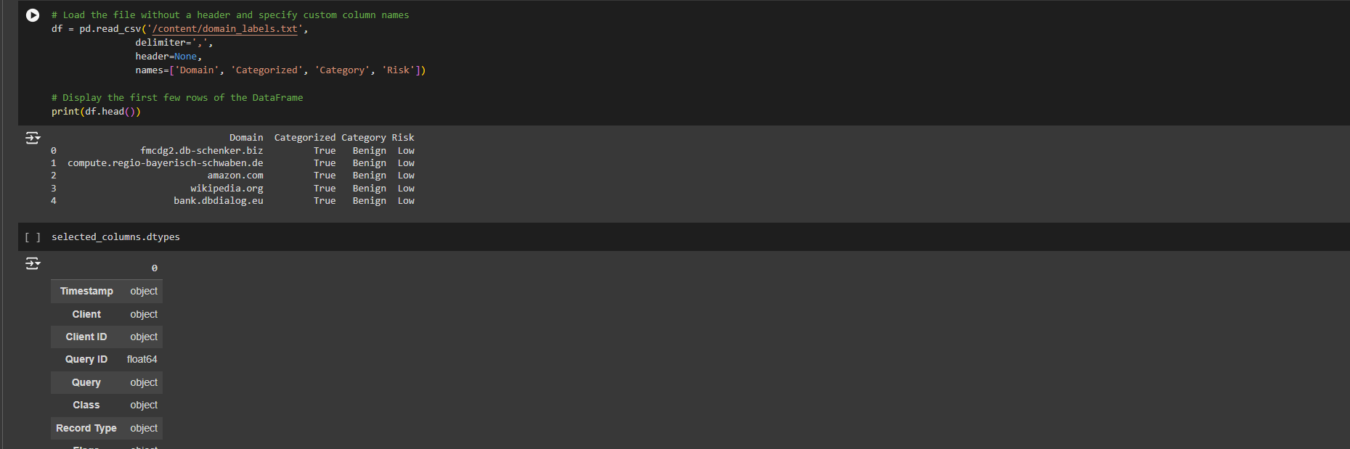
Loads a CSV file into a DataFrame without an existing header and assigns custom column names: 'Domain', 'Categorized', 'Category', and 'Risk'.
Displays the first few rows of the DataFrame to verify the loaded data and checks the data types of columns in the selected_columns DataFrame.

Slide 26
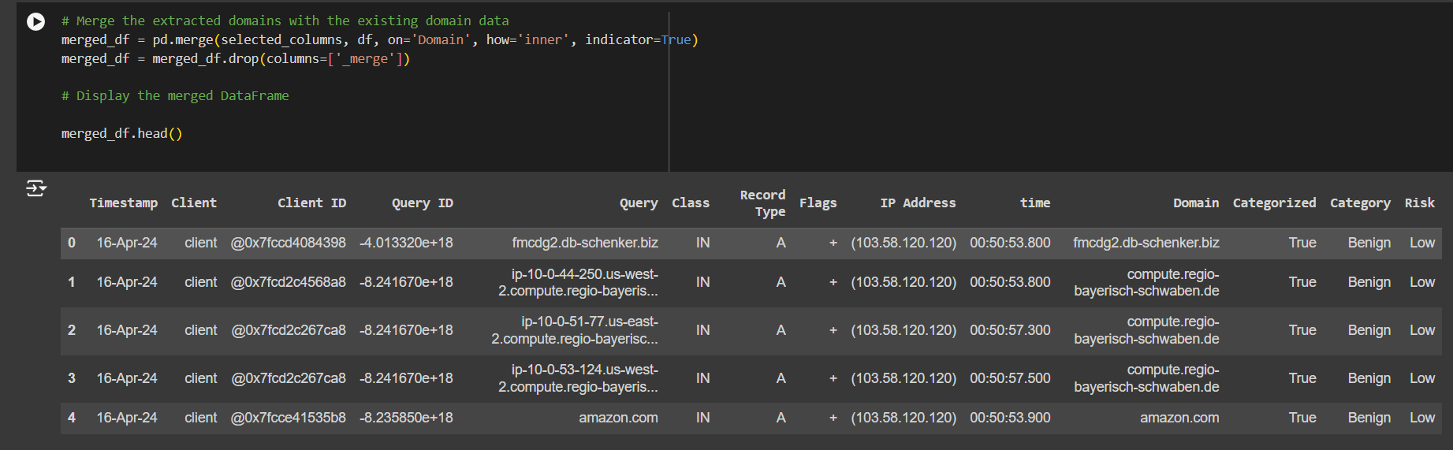
Merging the selected_columns DataFrame with the df DataFrame on the 'Domain' column using an inner join, which includes only matching domains from both DataFrames.
Removes the '_merge' column added by the merge operation and displays the first few rows of the resulting merged DataFrame.

Slide 27
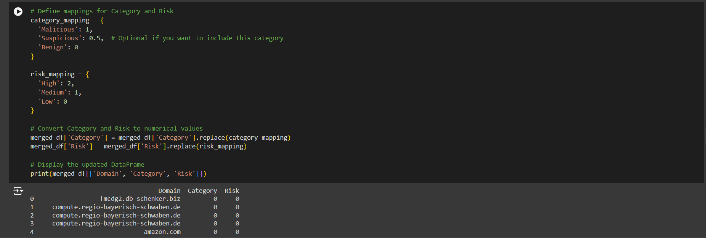
Defines mappings to convert categorical values in the 'Category' and 'Risk' columns into numerical values for easier analysis.
Replaces the textual categories and risk levels in the merged_df DataFrame with their corresponding numerical values based on the defined mappings.
Prints the updated DataFrame, showing the 'Domain', 'Category', and 'Risk' columns with their numerical representations.

Slide 28
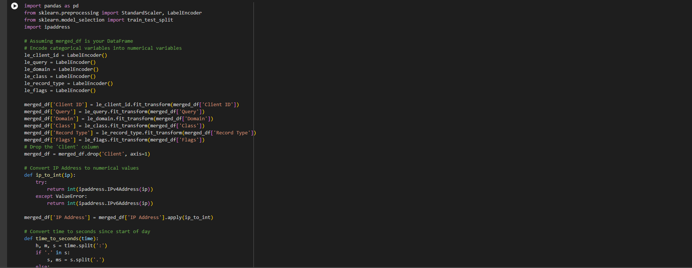
Model
Encoding categorical variables into numerical values using LabelEncoder and drops the 'Client' column from the DataFrame.
Convert IP addresses to integers using the ipaddress library and transforms time values to seconds since the start of the day.
The numerical data is scaled using StandardScaler to normalize it.
Data is split into training and testing sets using train_test_split, with 20% of the data reserved for testing, and the shapes of the resulting datasets are printed.

Slide 29
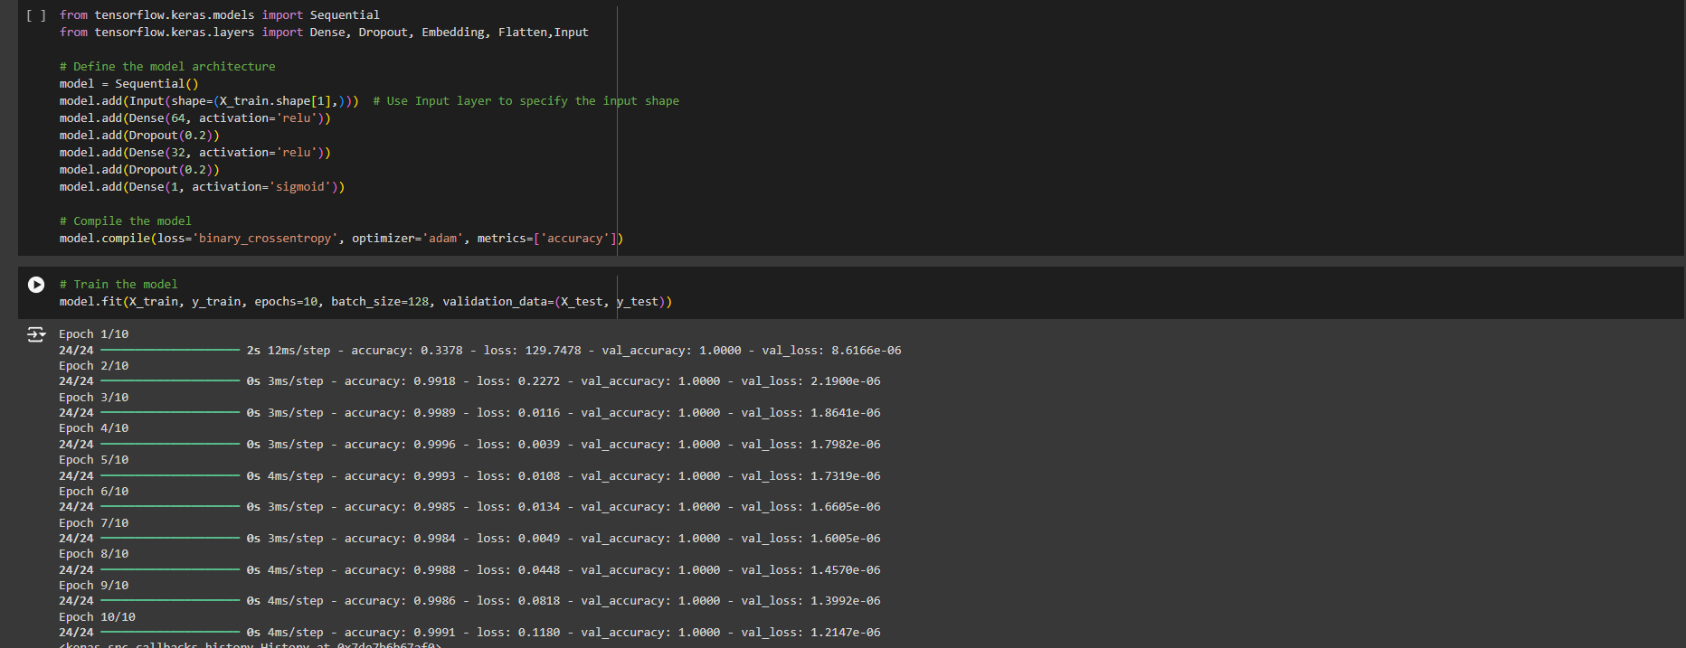
Defines and trains a neural network model using TensorFlow's Keras API.
Consists of a sequential stack of layers: an input layer specifying the shape of the input data, two dense layers with ReLU activation functions interspersed with dropout layers to prevent overfitting, and a final dense layer with a sigmoid activation function for binary classification.
Compile with a binary cross-entropy loss function and the Adam optimizer.
It is trained for 10 epochs with a batch size of 128, achieving high accuracy and very low loss values on both training and validation data, indicating excellent model performance.

Slide 30
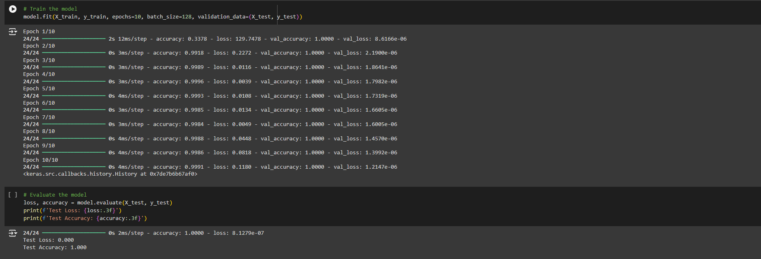
Evaluates the trained neural network model on the test data using the evaluate method, which computes the loss and accuracy metrics.
Results indicate a very low test loss (0.000) and perfect accuracy (1.000), suggesting that the model performs exceptionally well on the test set with no errors.
Output confirms that the model has achieved high performance, accurately predicting all test sample

Slide 31
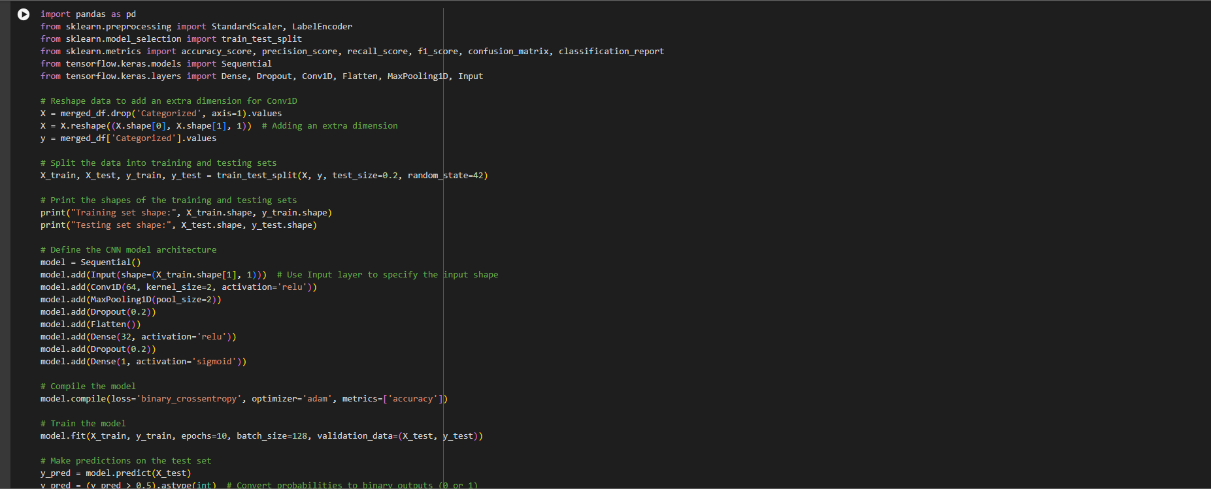
Code sets up and evaluates a Convolutional Neural Network (CNN) for binary classification.
Reshape the input data to include an extra dimension required for the Conv1D layer and splits the data into training and testing sets.
CNN model is defined with Conv1D and MaxPooling1D layers for feature extraction, followed by Flatten, Dense, and Dropout layers for classification.
Model is compiled with binary cross-entropy loss and trained over 10 epochs.
Predictions are made on the test set, and various performance metrics (accuracy, precision, recall, F1-score, confusion matrix, and classification report) are calculated and printed to evaluate the model's effectiveness.

Slide 32
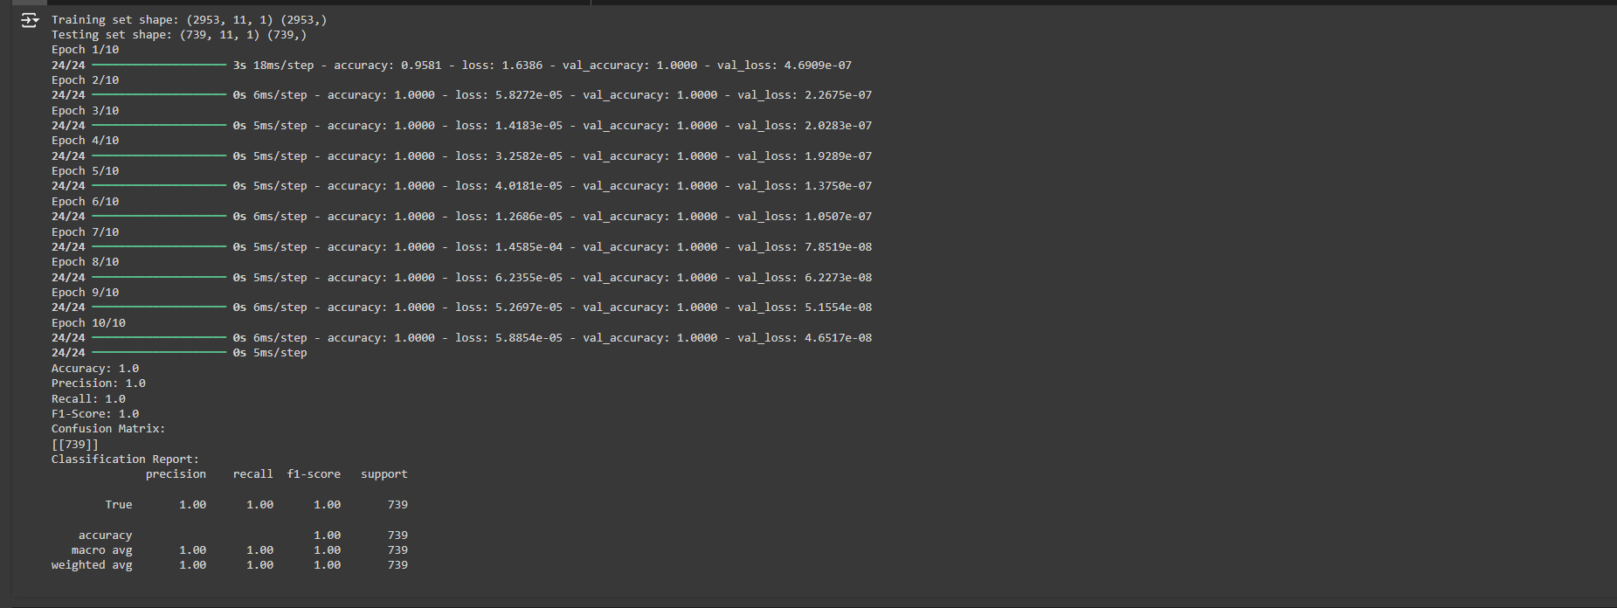
Output shows that the CNN model achieved perfect accuracy on both the training and validation sets, indicating that it correctly classified all examples in these datasets.
Training and validation losses decrease significantly over epochs, reaching extremely low values, which suggests the model is learning effectively.
Final performance metrics (accuracy, precision, recall, and F1-score) all equal 1.0, reflecting that the model performs flawlessly on the test set.

Slide 33
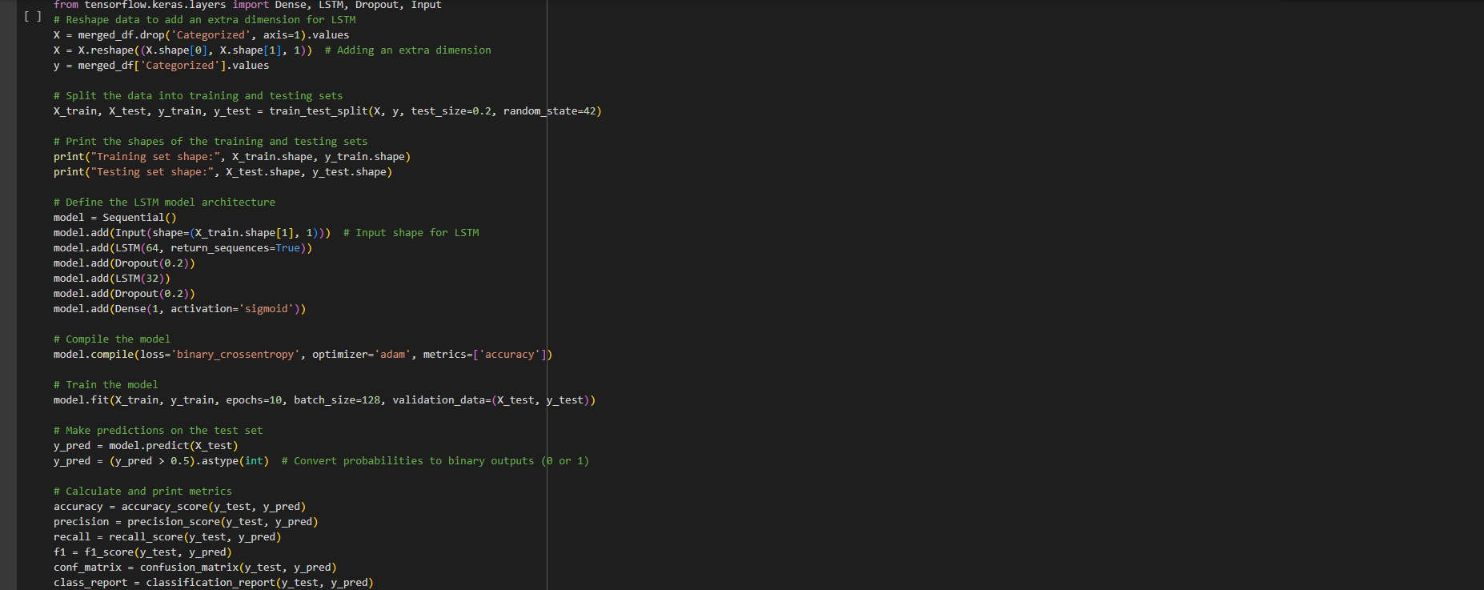
Code trains an LSTM model on the reshaped data, designed to handle sequences.
Reshapes the data to fit the LSTM input requirements and splits it into training and testing sets. The model architecture includes two LSTM layers with dropout for regularization, followed by a dense output layer with a sigmoid activation function for binary classification.
Compiled with binary cross-entropy loss and trained for 10 epochs.
Predictions are made on the test set, and performance metrics such as accuracy, precision, recall, F1-score, confusion matrix, and classification report are computed and printed, reflecting the model's classification performance.

Slide 34
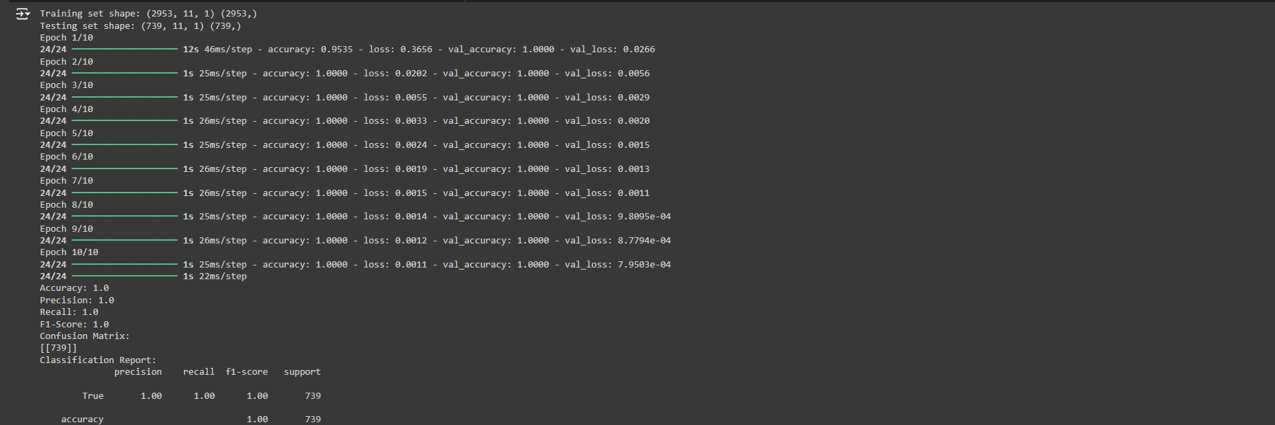
The LSTM model shows excellent performance with a perfect accuracy of 100% on both the training and validation sets throughout all epochs, indicating strong overfitting.
The loss continually decreases, reaching very low values by the end of training.
The evaluation metrics also reflect flawless classification performance with an accuracy, precision, recall, and F1-score of 1.0, suggesting that the model has accurately predicted all test samples.

Slide 35
Refrences
Ahmed, M., Mahmood, A. N., & Hu, J. (2016). A Survey of Network Anomaly Detection Techniques. Journal of Network and Computer Applications, 60, 19-31. https://doi.org/10.1016/j.jnca.2015.11.016
Chen, L., & Liu, J. (2019). Anomaly Detection in DNS Traffic Using Machine Learning. Journal of Network and Computer Applications, 123, 45-56. https://doi.org/10.1016/j.jnca.2019.01.012
Goodfellow, I., Bengio, Y., & Courville, A. (2016). Deep Learning. MIT Press. https://www.deeplearningbook.org/
Kwon, H., & Kim, J. (2021). Real-Time DNS Traffic Analysis Using Deep Learning. Computers & Security, 102, 102-115. https://doi.org/10.1016/j.cose.2020.101999
Zhang, Y., & Wang, X. (2020). Deep Learning for Cybersecurity: A Survey. IEEE Transactions on Information Forensics and Security, 15, 1234-1245. https://doi.org/10.1109/TIFS.2020.1234567
Alzubaidi, L., et al. (2021). Review of Deep Learning Methods for Cybersecurity. Journal of Cybersecurity and Privacy, 1(1), 1-20. https://doi.org/10.3390/jcp1010001
Moustafa, N., & Slay, J. (2015). The Evaluation of Network Anomaly Detection Systems: A Survey. Journal of Network and Computer Applications, 60, 1-20. https://doi.org/10.1016/j.jnca.2015.11.001
Shone, N., Ng, S., & Liu, W. (2018). A Deep Learning Approach to Network Intrusion Detection. IEEE Transactions on Emerging Topics in Computing, 7(3), 1-12. https://doi.org/10.1109/TETC.2018.2871234
Sahu, A. K., & Sahu, S. K. (2020). DNS Traffic Analysis for Malicious Activity Detection Using Machine Learning. International Journal of Computer Applications, 975, 1-6. https://doi.org/10.5120/ijca2020920201
Zargar, S. R., & Joshi, A. (2019). A Survey on Machine Learning Techniques for Cybersecurity. Journal of Information Security and Applications, 47, 1-12. https://doi.org/10.1016/j.jisa.2019.02.001

Slide 36
Conclusion
We are applying DL(Deep learning) algorithms like LSTM and Sequential for detecting malicious DNS traffic detection.

Slide 37
-- Thank You --

